Slide 1
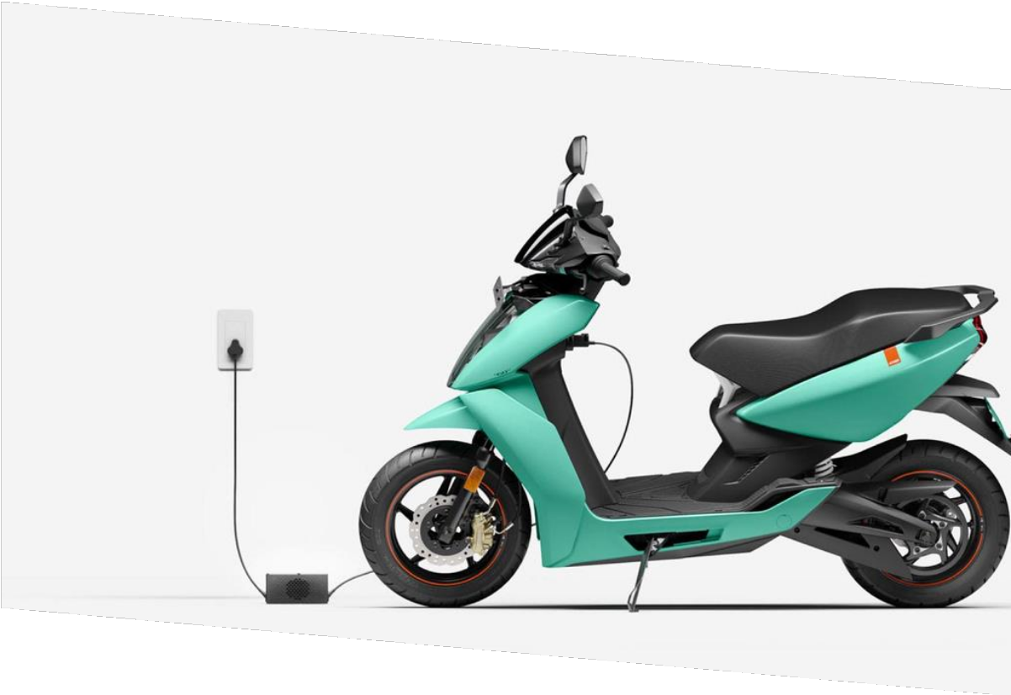
SMART ELECTRIC VEHICLES (EV’s) BATTERY FIRES EXTINGUISHING SYSTEM

Slide 2


PROBLEM STATEMENT
01
Thermal Runaway Risks :
Lithium-ion batteries in EVs face challenges with thermal runaway, which can lead to fires or explosions in extreme conditions.
CUST0MER SEGMENTATION
02
Inefficiency of Current Cooling Systems : Conventional cooling systems, such as air, water, and glycol-based coolants, are energy-intensive, inefficient, and prone to risks like short circuits and fire exacerbation.
Electric Vehicle Manufacturers & Suppliers.
EV companies aiming to enhance battery safety and thermal management.
Battery Manufacturers
EV Owners and Consumers
Government and Regulatory Bodies
Energy Dependence on Main Battery :
Current systems rely heavily on the EV's main battery, reducing overall energy efficiency and vehicle range.
03
Safety and Efficiency Concerns :
These limitations pose critical safety and operational challenges for EVs.
04

Slide 3
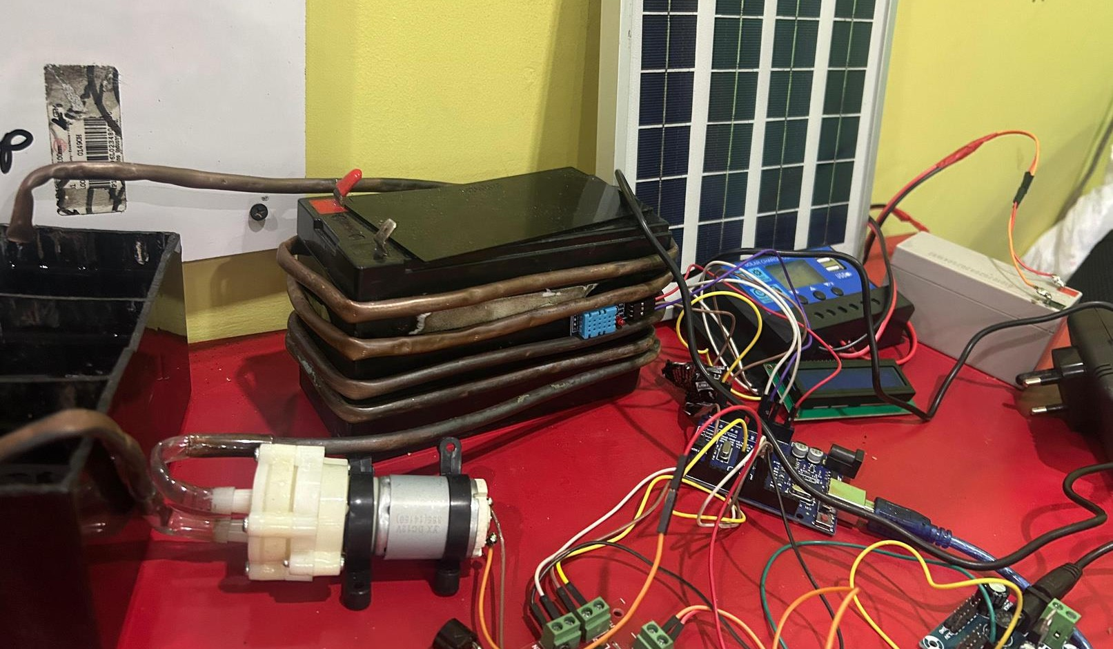
SOLUTIONS
Three-Chamber Cooling System
The cooling system's three-chamber design includes one chamber for supplying synthetic coolant oil to absorb battery heat and two chambers for cooling the heated oil. This setup ensures efficient heat dissipation and continuous coolant cycling without overheating.
02
03
Synthetic Coolant Oil Circulation as Coolant
The system circulates synthetic coolant oil to absorb and dissipate heat from the battery.Adding boric acid improves performance by clearing impurities and enhancing cooling efficiency. It also ensures the coolant oil remains effective and uncontaminated through repeated cycles.
Microcontroller Based Temperature Monitoring
01
04
Solar Panels Powered Rechargeable Battery
A microcontroller monitors battery temperature using integrated sensors, displaying real-time data on the speedometer. When the temperature exceeds a critical threshold, it triggers driver notifications and alarms for early intervention.
Solar panels are used to generate electricity, which is stored in a rechargeable battery. This setup ensures the system is energy-independent, reducing the load on the EV's main battery and enhancing sustainability.

Slide 4
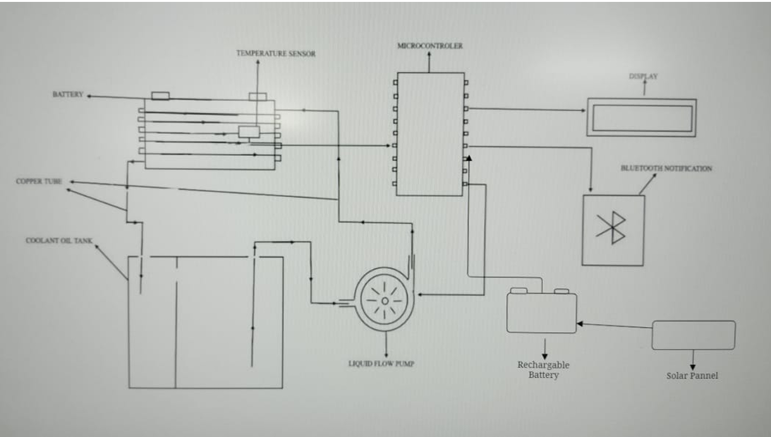
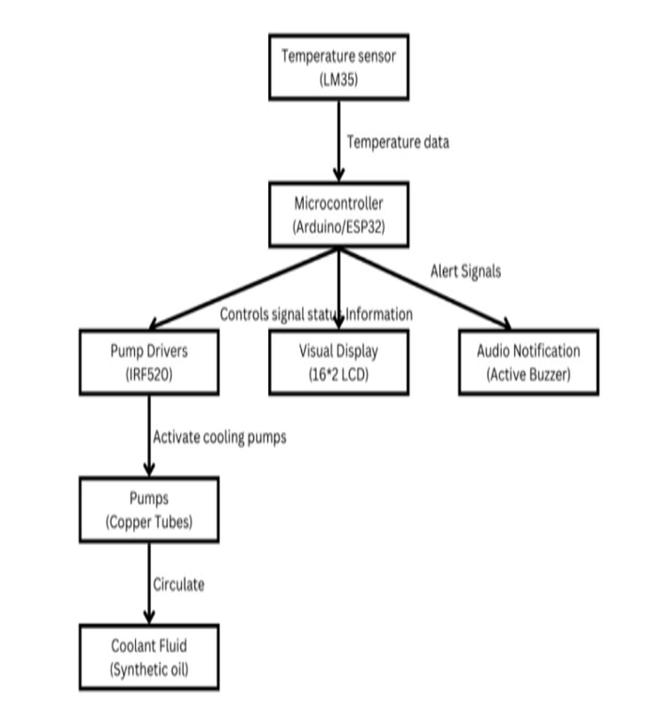
ARCHITECTURE DIAGRAM
WORK FLOW DIAGRAM
.

Slide 5
HOW MY SYSTEM IS UNIQUE FROM EXISTING ONES
Boric Acid Enhanced Coolant
Most current systems use standard coolants, but your system introduces boric acid as a performance improver. This addition helps in impurity removal, keeps the synthetic oil uncontaminated, and maintains long-term cooling efficiency—an innovative chemical enhancement.
02
03
Energy Independence with Solar Integration:
While existing systems rely entirely on the EV’s main battery, your design uses solar panels with rechargeable storage to power the cooling cycle. This reduces load on the main EV battery, extends driving range, and supports sustainability.
01
Three-Chamber Cooling Innovation:
Unlike traditional single-loop liquid cooling, your system uses a dedicated three-chamber design (one for heat absorption and two for cooling) that ensures continuous circulation, prevents overheating, and maximizes heat dissipation efficiency.
04
Proactive Driver Alerts:
Your system not only cools but also integrates with the speedometer display and notification system to give real-time battery temperature readings and alarms. This early-warning mechanism enhances driver awareness and safety, which many existing cooling systems lack.

Slide 6
BUSINESS MODEL
VALUE CAPTURE & DELIVERY :
Product Sales :
Revenue from selling the EV fire prevention system to individual
consumers and businesses.
  Collaborating with original equipment manufacturers
(OEMs) to integrate our system into new EV models, generating
income through bulk sales and licensing agreements.
VALUE PROPOSITION :
Target Customers :
Electric Vehicle Manufacturers
& Suppliers.
  EV Owners and Consumers
What we offer :
Enhanced Safety
Improved Performance
Durability and Reliability
Cost Efficiency

Slide 7
